Slide 1
Inventory Report
Team: POSH Monks Winter Scripting Games 2014 - Event:00 (Practice)

Slide 2
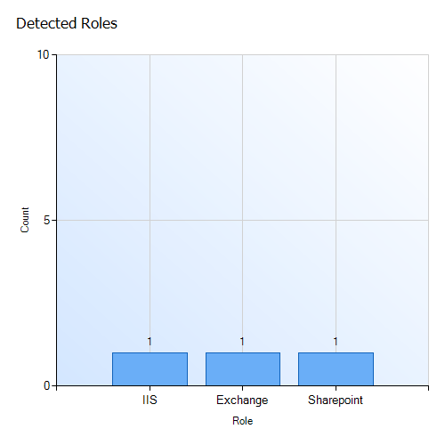
Roles

Slide 3
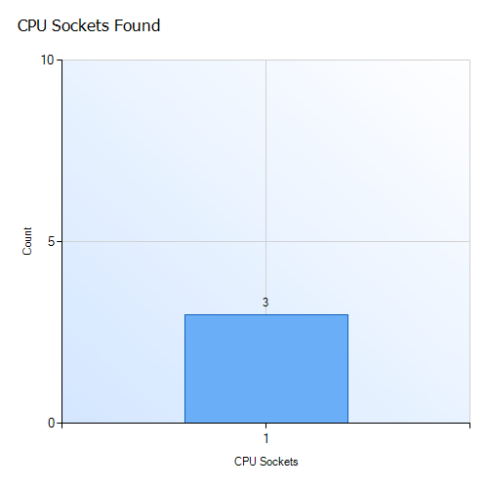
NumberOfProcessors

Slide 4
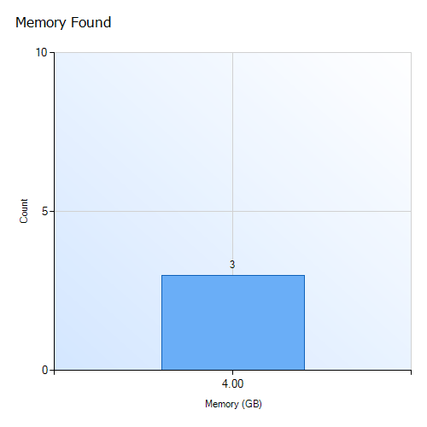
MemoryGB

Slide 5
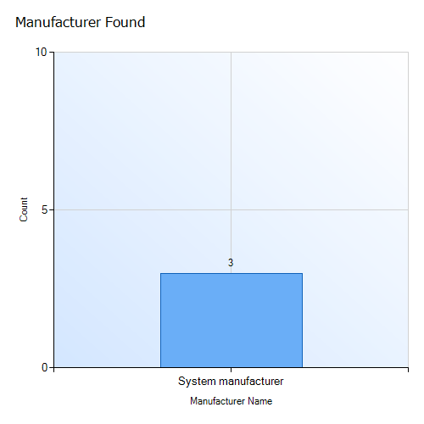
Manufacturer

Slide 6

Model

